Slide 1


Finaxial AI: Automated Financial Reporting
Faculty Mentor – Dr. Ch.Sekhar Team Turing Machines
Shaik Najeer (Leader) – 22341A4253 - Frontend login and backend Integration Mohan – 22341A4205 - Backend Infrastructure and Devops
Praveen – 22341A4263 - Frontend UI/UX
Pradeep – 22341A4214 – Backend API and Database
GMR Institute of Technology(Deemed University), Rajam

Slide 2
Problem Statement:
Preparing financial reports, including income statements, balance sheets, cash flow statements, is time-consuming and prone to errors,especially with large datasets.
Impact:
Time savings for finance teams.
Real time financial insights for stakeholders.
Reduced operational costs.
Objective:
Operational Efficiency and Cost Reduction:
Automating financial reporting reduces manual effort, minimizes errors, and streamlines data processing. This leads to significant cost savings by decreasing reliance on large finance teams.
Real-Time Strategic Decision-Making
Instant generation of financial insights like revenue trends and profitability enables quicker, data-driven decisions. This responsiveness enhances an organization's agility in dynamic market conditions.
Improved Compliance and Accuracy
Generative AI ensures consistency and accuracy in reports, supporting compliance with financial regulations. This lowers the risk of penalties and boosts confidence among investors and auditors.

Slide 3
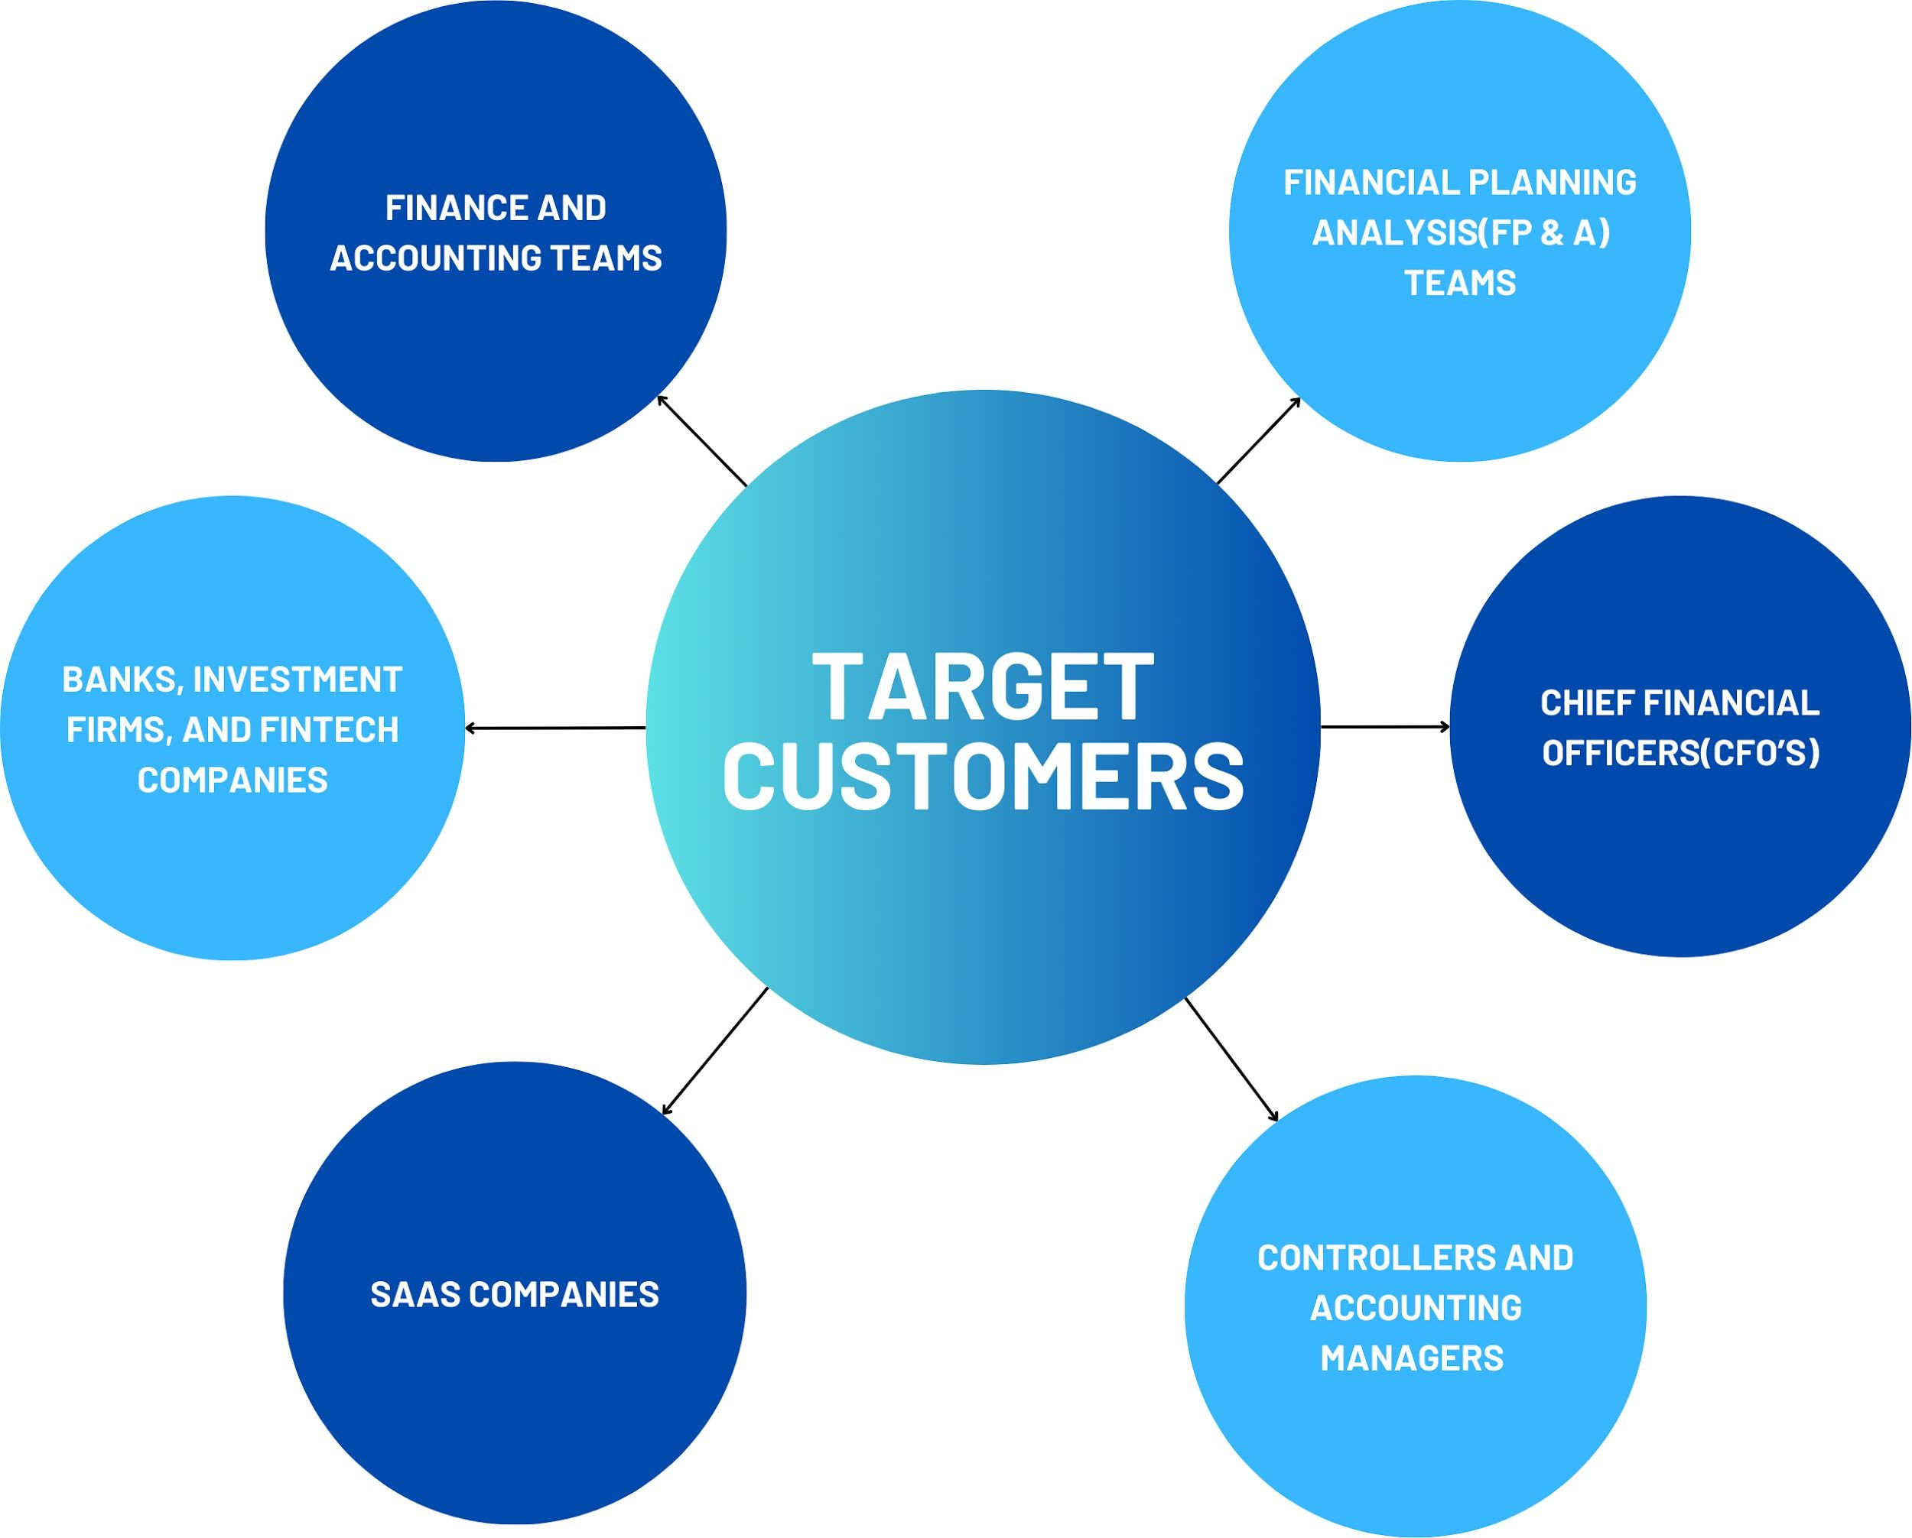
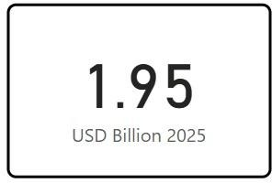
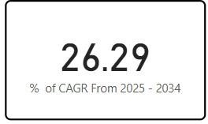
Target Segment / Market Size:
Intended Customers / Targeted Segments:
Market Size
Global Generative AI in Financial services is predicted to surpass around 15.69 USD Billion by 2034
Compound Annual Growth Rate is set to increase drastically by 2034

Slide 4
Existing Solutions / Platforms vs Finaxial AI:
Feature | Finaxial AI | iWaever AI | Parseur | Other Platforms
Interactive ER Duagram(Schema Visualization) | Yes | No | No | No
SQL Query Generation from Uploaded Data | Yes | No | No | No
Data Versioning System (Compare/Revert Uploads) | Yes | No | No | No
Detailed Audit Trail (Data + User Actions + AI Queries) | Yes | Basic usage logs only | No | Partial(Active logs only)
ETL Pipeline for Multi-Sheet and Complex Data | Yes | No | Yes(Data Extraction Only) | No
In-Platform Annotation & Commenting System | Yes | No | No | No

Slide 5
Existing Solutions / Platforms vs Finaxial AI:
Feature | Finaxial AI | iWaever AI | Parseur | Other Platforms
Schema-Aware Conversational Assistant | Yes-Powered by Gemini AI | No | No | No
AI Assistant for Financial Q&A + SQL + Schema Awareness | Yes - AI assistant answers financial queries & generates SQL | Yes - NLP chat for follow-ups (no SQL/schema) | No | No
Use of Gemini AI for Visualizations, Summaries, Insights, Recommendations | Yes - Gemini API used to generate smart reports with insights & visual summaries | No (uses internal GPT-like model for summaries) | No | No
Export to PDF and Send via Email | Yes - auto-generated reports can be exported as PDF,Word,XML and shared by email | Export in PDF, Word, Markdown | Only parsed text output | Partial - PDF export in some tools
Handles Complex Financial Data with Multiple Files and Sheets | Yes - multi-file processing built-in with schema merge & dynamic column handling | Yes - accepts 20+ files but limited schema control | Yes - multi-document parsing only | No

Slide 6
Why our solution is accurate?
Google Gemini AI Integration: Advanced natural language processing ensures contextually accurate financial analysis by leveraging domain-specific knowledge bases. RAG architecture grounds AI responses in established financial principles, eliminating hallucinations and providing reliable insights backed by regulatory standards.
Multi Format Data Ingestion: CSV and Excel parsing with intelligent validation detects inconsistencies, missing values, and formatting errors before analysis. Automated data cleansing and normalization ensure standardized input for consistent, accurate calculations across all financial metrics.
Multi-Standard Regulatory Checking: Simultaneous validation against GAAP, IFRS, and SOX standards ensures regulatory accuracy while comprehensive audit trails maintain data integrity throughout the analysis lifecycle.
Multi-Layer Verification System: Combines automated validation, statistical verification, and regulatory compliance checking to achieve 95%+ precision rate across all financial calculations and insights generation processes.
Fallback Mechanisms: Three-tier validation system (vector search → text search → generic knowledge) with intelligent retry logic ensures 99.9% system reliability. Comprehensive error detection prevents invalid data from compromising analysis accuracy.
Accuracy Guarantee: Our comprehensive validation framework ensures 95%+ precision through AI grounding, regulatory compliance, statistical verification, and domain-expert knowledge integration.

Slide 7
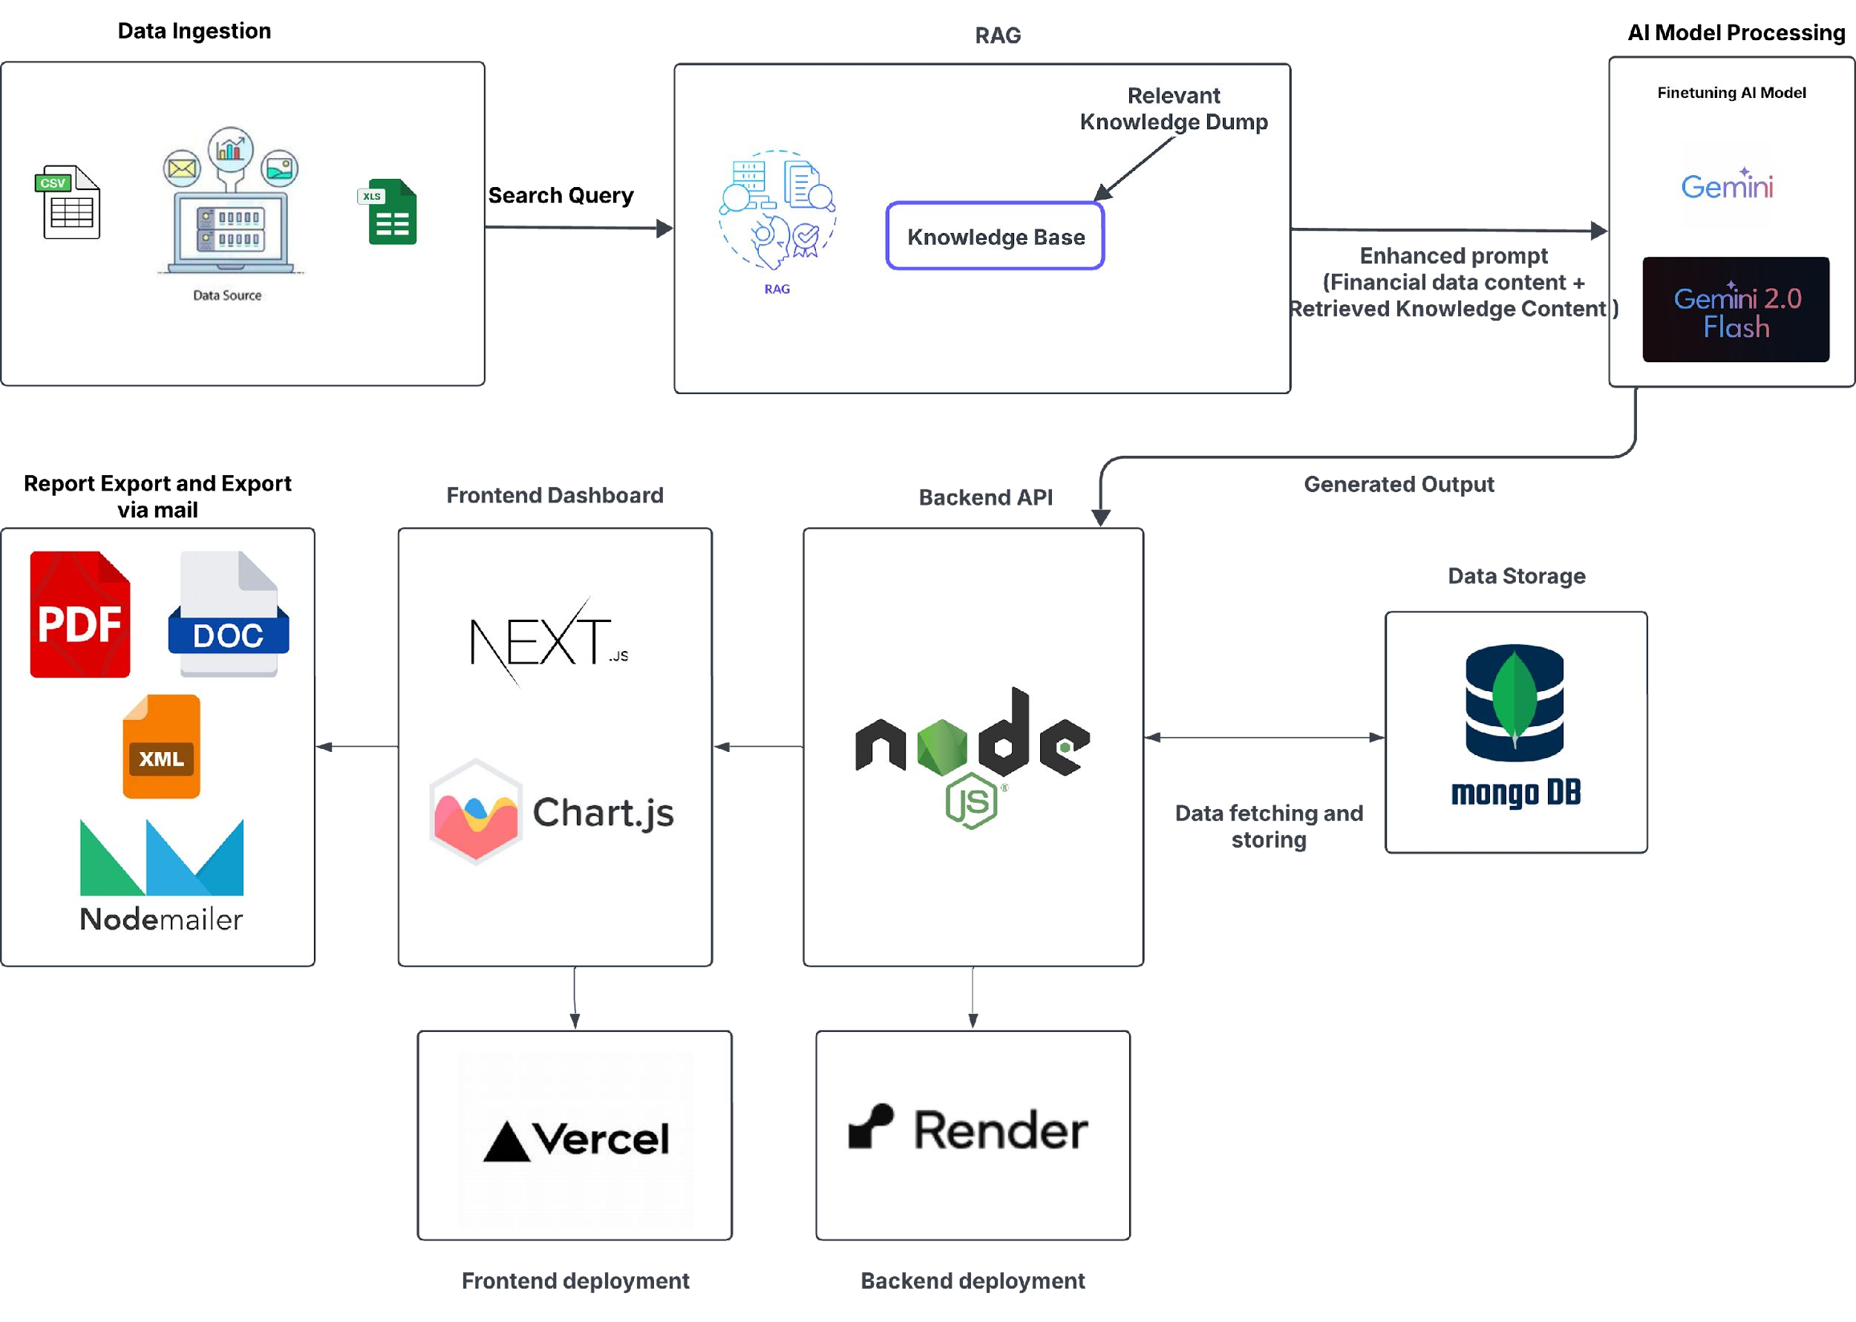
Architecture:
Full-Stack AI-Driven Architecture: End-to-end financial analysis platform leveraging Gemini 2.0 Flash for intelligent data processing, Next.js frontend with Chart.js visualizations, Node.js backend API, and MongoDB storage with automated PDF report generation and email distribution capabilities.

Slide 8
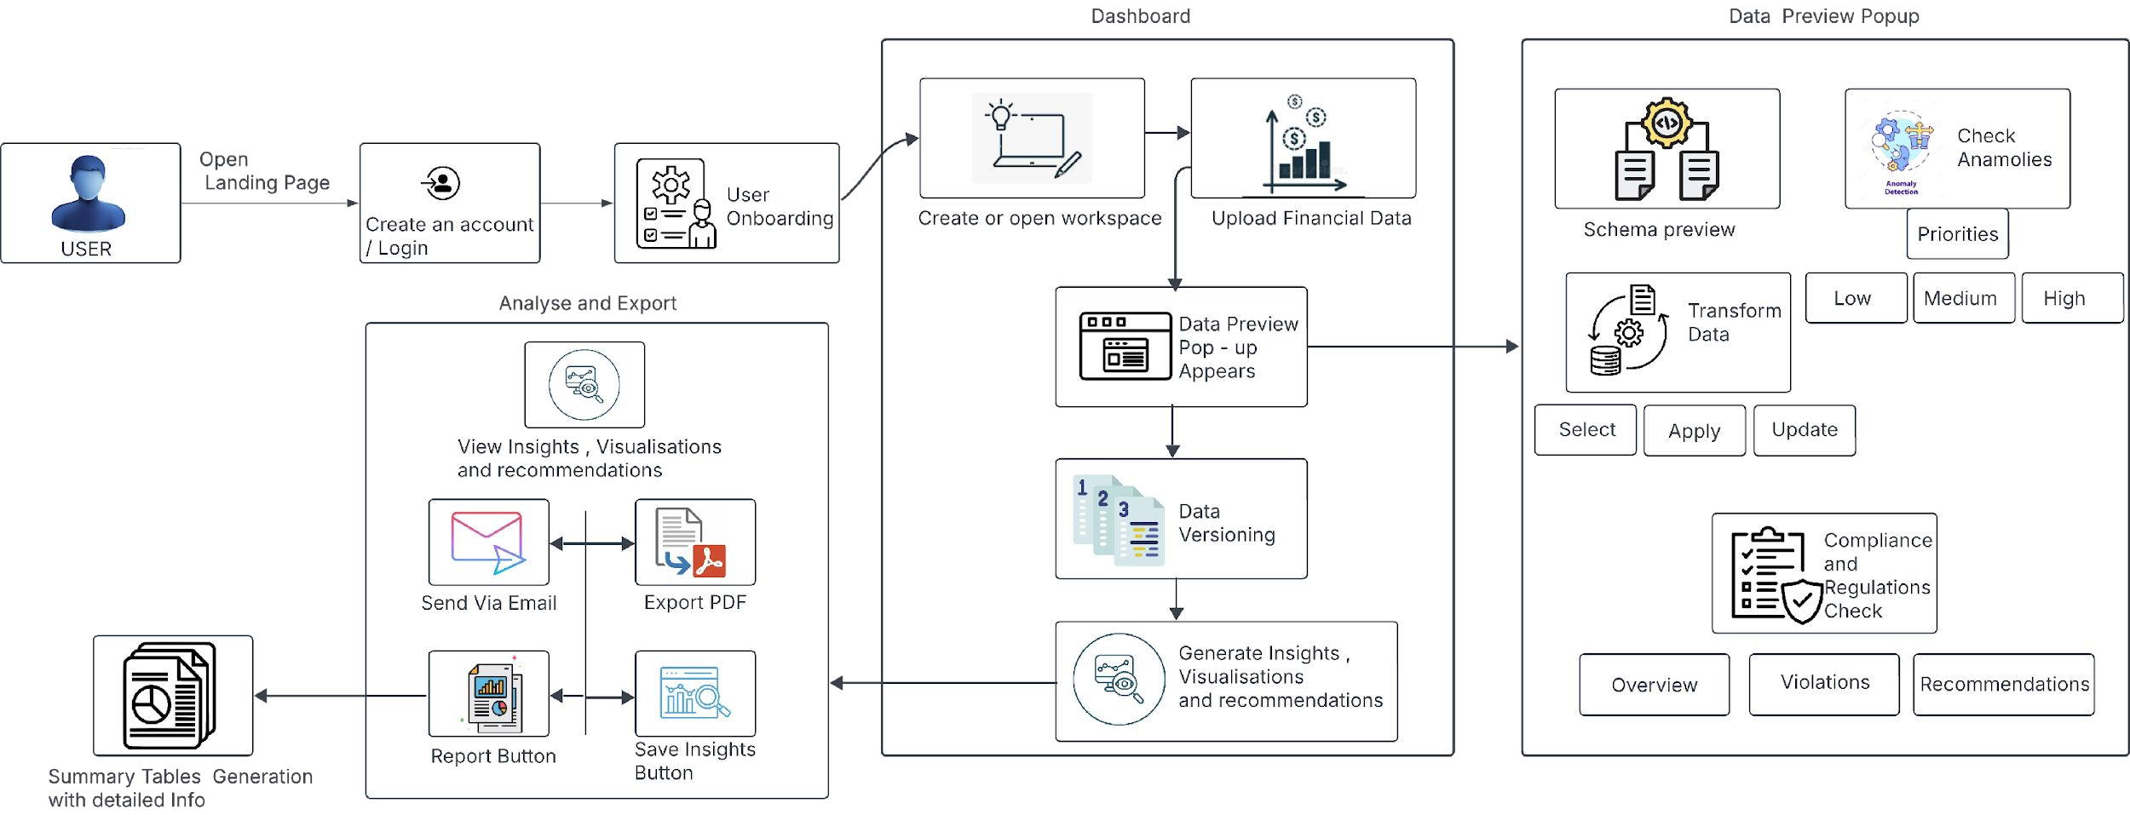
User flow Chart:
Comprehensive User Journey Architecture: Streamlined workflow from secure user onboarding through workspace creation, multi-format data upload with interactive preview, AI-powered anomaly detection and compliance checking, to automated insights generation with professional report export and email distribution capabilities.

Slide 9
Cloud Services Comparison for Deploying Gemini Model:
Comoponent | AWS Service | GCP Service | Azure Service
Frontend Hosting | S3+CloudFront | Cloud Storage+Cloud CDN | Azure Blob Storage+Azure CDN
Backend API | ECS Fargate/Lambda | Cloud Run/Cloud Functions | Azure Container Apps/Azure Functions
Database | DocumentDB/RDS | Firestore/Cloud SQL | Cosmos DB/Azure SQL Database
Load Balancer | Application Load Balancer | Cloud Load Balancing | Azure Load Balancer/Application Gateway
DNS | Route S3 | Cloud DNS | Azure DNS
Monitoring | CloudWatch+X-Ray | Cloud Operations Suite | Azure Monitor+Application Insights
Security | IAM+WAF+Secrets Manager | IAM+Cloud Armor | Azure Active Directory+Azure Firewall
CI/CD | CodePipeline+CodeBuild | Cloud Build+Cloud Deploy | SAzure DevOps/GitHub Actions/Azure Pipelines

Slide 10
Conclusion:
What it is:
An AI-powered financial analysis platform that transforms raw financial data into actionable business intelligence through automated processing, compliance validation, and professional report generation with RAG-enhanced insights.
Key Features:
Multi-Format Data Integration: CSV/Excel upload with batch processing and cross-file analysis.
AI-Driven Analytics: Machine learning anomaly detection, data transformation, and RAG-enhanced insights.
Comprehensive Compliance: GAAP/IFRS/SOX validation with automated violation detection.
Professional Reporting: PDF generation with embedded visualizations and executive summaries.
Interactive Intelligence: Conversational AI assistant with real-time financial analysis capabilities
Benefits:
Cost Optimization:Cost reduction accounting for over 33% of analytics value, with companies identifying inefficiencies and streamlining processes
Productivity Enhancement:Productivity improvements of 10-20% through reduced decision hesitancy and error rates
Process Automation:Automated reporting that eliminates manual data compilation and reduces processing time by up to 30%

Slide 11
Conclusion:
Replicability:
The modular architecture enables seamless adaptation across industries by customizing AI models, compliance frameworks, and reporting templates. Core RAG infrastructure supports sector-specific knowledge bases while maintaining consistent analytical capabilities.
Data Governance:
Implements bank-level security protocols with end-to-end encryption,comprehensive audit logging, and GDPR compliance to ensure data integrity and regulatory adherence throughout the analytical lifecycle.

Slide 12
Future Enhancements:
Enterprise Integration and Connectiivty:
ERP System Integration: Direct connectivity with SAP, Oracle, QuickBooks, and major accounting platforms.
Real-Time Data Streaming: Live financial feeds with instant alerts and continuous monitoring capabilities.
API Ecosystem: Comprehensive RESTful APIs for third-party integrations and workflow automation.
Blockchain Integration: Immutable audit trails and smart contract validation for enhanced transparency.
Enhanced User Experience:
Mobile Native Applications: Dedicated iOS/Android apps with offline analysis and synchronization capabilities.
Voice-Activated Interface: Hands-free financial queries and report generation through conversational AI.
Collaborative Workflows: Real-time co-editing, approval processes, and team-based analysis features.
Customizable Dashboards: Drag-and-drop interface with personalized KPI tracking and visualization.
Platfrom Scalability:
Cloud-Native Infrastructure: Kubernetes-based auto-scaling with high availability deployment.
Edge Computing: Local processing capabilities for improved latency and data sovereignty requirements.
Microservices Architecture: Enhanced service decomposition for improved maintainability and performance.
Advanced Caching Systems: Redis-based optimization for faster report generation and analysis processing.

Slide 13
Thank You

